Slide 1
Analysis of Variance

Slide 2
Experimental Design
Investigator controls one or more independent variables
  Called treatment variables or factors
  Contain two or more levels (subcategories)
Observes effect on dependent variable
  Response to levels of independent variable
Experimental design: Plan used to test hypotheses
Notes:
76

Slide 3
Parametric Test Procedures
Involve population parameters
  Example: Population mean
Require interval scale or ratio scale
  Whole numbers or fractions
  Example: Height in inches: 72, 60.5, 54.7
Have stringent assumptions
  Examples:
  Normal distribution
  Homogeneity of Variance
  Examples: z - test, t - test
Notes:
13

Slide 4
Nonparametric Test Procedures
Statistic does not depend on population distribution
Data may be nominally or ordinally scaled
  Examples: Gender [female-male], Birth Order
May involve population parameters such as median
Example: Wilcoxon rank sum test
Notes:
14

Slide 5

Advantages of Nonparametric Tests
Used with all scales
Easier to compute
  Developed before wide computer use
Make fewer assumptions
Need not involve population parameters
Results may be as exact as parametric procedures
© 1984-1994 T/Maker Co.

Slide 6
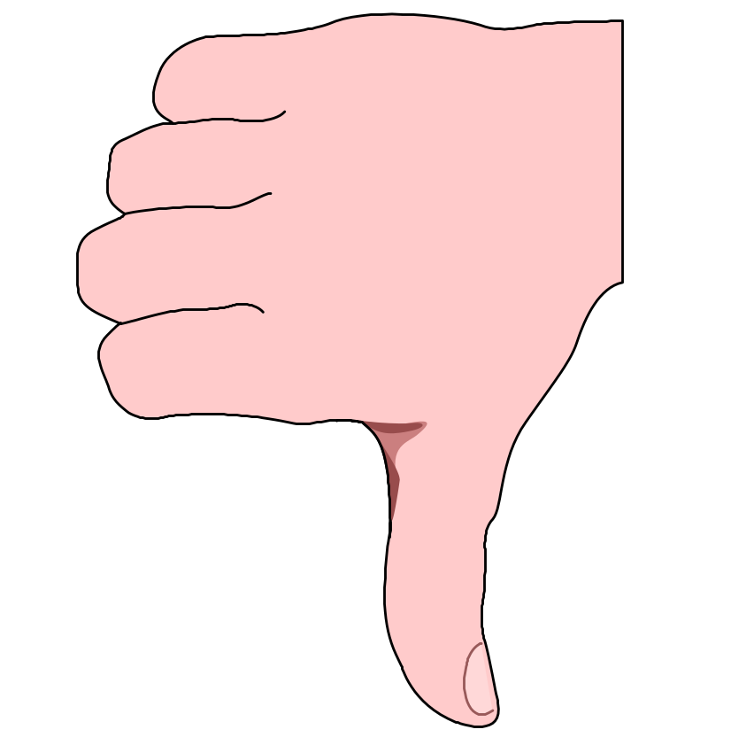
Disadvantages of Nonparametric Tests
May waste information
  If data permit using parametric procedures
  Example: Converting data from ratio to ordinal scale
Difficult to compute by hand for large samples
Tables not widely available
© 1984-1994 T/Maker Co.

Slide 7
ANOVA (one-way)
One factor,
completely randomized
design

Slide 8
Completely Randomized Design
Experimental units (subjects) are assigned randomly to treatments
  Subjects are assumed homogeneous
One factor or independent variable
  two or more treatment levels or classifications
Analyzed by [parametric statistics]:
  One-and Two-Way ANOVA
Notes:
77

Slide 9
Mini-Case
After working for the Jones Graphics Company for one year, you have the choice of being paid by one of three programs:
- commission only,
- fixed salary, or
- combination of the two.

Slide 10

Salary Plans
Commission only?
Fixed salary?
Combination of the two?

Slide 11
Is the average salary under the various plans different?

Slide 12
Assumptions
Homogeneity of Variance
Normality
Additivity
Independence

Slide 13
Homogeneity of Variance
Variances associated with each treatment in the experiment
are equal.

Slide 14
Normality
Each treatment population is normally distributed.

Slide 15
Additivity
The effects of the model behave in an additive fashion [e.g. : SST = SSB + SSW].
Non-additivity may be caused by the multiplicative effects existing in the model, exclusion of significant interactions, or by “outliers” - observations that are inconsistent with major responses in the experiment.

Slide 16
Independence
Assuming the treatment populations are normally distributed,
the errors are not correlated.

Slide 17
One-Way ANOVA
Compares two types of variation to test equality of means
Ratio of variances is comparison basis
If treatment variation is significantly greater than random variation … then means are not equal
Variation measures are obtained by ‘partitioning’ total variation

Slide 18

ANOVA (one-way)

Slide 19
ANOVA Partitions Total Variation
Total variation

Slide 20



ANOVA Partitions Total Variation
Total variation
Variation due to treatment

Slide 21



ANOVA Partitions Total Variation
Total variation
Variation due to treatment
Variation due to random sampling

Slide 22
ANOVA Partitions Total Variation
Total variation
Variation due to treatment
Variation due to random sampling
Sum of squares among
Sum of squares between
Sum of squares model
Among groups variation

Slide 23
ANOVA Partitions Total Variation
Total variation
Variation due to treatment
Variation due to random sampling
Sum of squares among
Sum of squares between
Sum of squares model
Among groups variation
Sum of squares within
Sum of squares error
Within groups variation

Slide 24
Hypothesis
H₀: μ₁ = μ ₂ = μ ₃
H₁: Not all means are equal
tests: F -ratio = MSB / MSW
p-value < 0.05

Slide 25
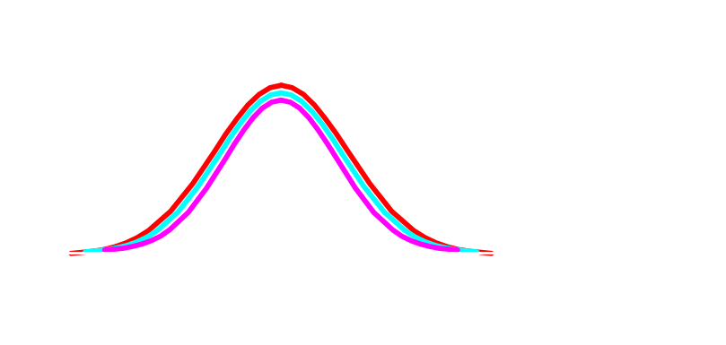
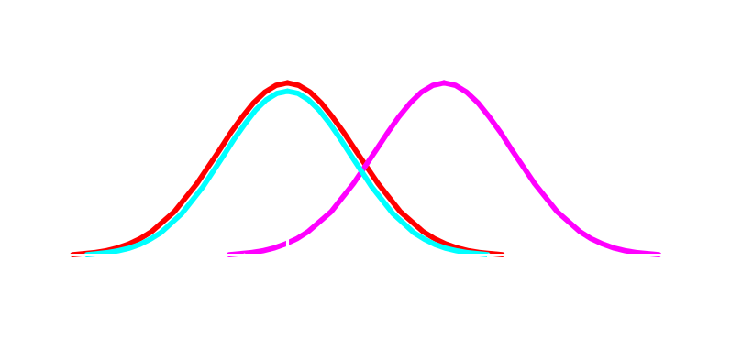
One-Way ANOVA
H₀: μ₁ = μ₂ = μ₃
  All population means are equal
  No treatment effect
H₁: Not all means are equal
  At least one population mean is different
  Treatment effect
  ΝΟΤΕ: μ₁ ≠ μ₂ ≠ μ₃
  is wrong
  not correct

Slide 26
StatGraphics Input

Slide 27

StatGraphics Results

Slide 28
Diagnostic Checking
Evaluate hypothesis
H₀: μ ₁ = μ ₂ = μ ₃
H₁: Not all means equal
F-ratio = 3.001 {Table value = 3.89}
significance level [p-value] = 0.0877
Retain null hypothesis [ H₀ ]

Slide 29
ANOVA (two-way)
Two factor factorial design

Slide 30
Mini-Case
Investigate the effect of decibel output using four different amplifiers and two different popular brand speakers, and the effect of both amplifier and speaker operating jointly.

Slide 31
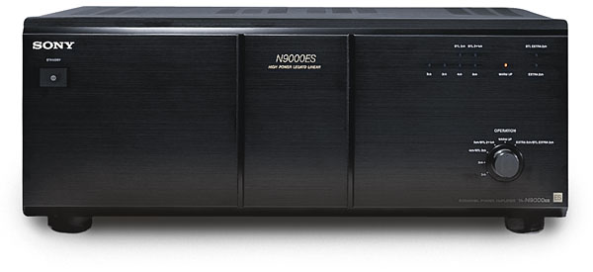

What effects decibel output?
Type of amplifier?
Type of speaker?
The interaction
between amplifier and speaker?

Slide 32

Are the effects of amplifiers, speakers, and interaction significant? [Data in decibel units.]

Slide 33
Hypothesis
Amplifier H₀: μ ₁ = μ ₂ = μ ₃ = μ ₄
H₁: Not all means are equal
Speaker H₀: μ ₁ = μ ₂
H₁: Not all means are equal
Interaction H₀: The interaction is not significant
H₁: The interaction is significant

Slide 34
StatGraphics Input

Slide 35

StatGraphics Results

Slide 36
Diagnostics
Amplifier p-value = 0.0372 Reject Null
Speaker p-value = 0.0014 Reject Null
Interaction p-value = 0.7917 Retain Null
Thus, based on the data, the type of amplifier and the type of speaker appear to effect the mean decibel output. However, it appears there is no significant interaction between amplifier and speaker mean decibel output.

